Slide 1
Satisfaction Survey
Flyfast Airlines
Sneha Binani
Manasi Gokhale
Manan Dedhia
Sudhanshu Kulkarni
Amit jadhav

Slide 2
Dataset
129886 rows and 28 columns
1. Satisfaction – it is rated from 1 to 5, that how satisfied is the customer?
2. Airline Status – each customer has a different type of airline status or package, which are platinum, gold, silver, and blue
3. Age – the specific customer’s age
4. Gender – male or female
5. Price Sensitivity – the grade to which the price affects to customers purchasing
6. Year of First Flight – this attributes shows the first flight of each single customer
7. No of Flights p. a. – this could be the number of flights that each customer has taken
8. Percent of Flight with other Airlines – how many time that customer fly with other Airlines.
9. Type of Travel – provides three traveling purpose for each consumer, which are business travel, mileage tickets that based on loyalty card, and personal travel like to see the family or in vacation
10. No. Of other Loyalty Cards – it is kind of membership card of each customer
11. Shopping Amount at Airport – showing the costumer’s result of how many products have been purchased
12. Eating and Drinking at Airport – it is the quantity eating and drinking per each consumer at the airport.
13. Class – it consisted of three different kinds of service level such as, business, and economy plus, economy

Slide 3
14. Day of Month – it means the traveling day of each consumer.
15. Flight date – all of these data are abbreviate the passenger’s flight date travel
16. Airline Code – basically, it is unique two or three digits that mean what is the specific type of airline. There are several codes that consumers have been going with. For example, AA, AS, B6, and DL.
17. Airline Name – There are several airlines company names such as, West Airways, Southeast Airlines Co, and FlyToSun Airlines Inc. This attribute provide what airline name that passenger have been used.
18. Origin City and Origin State – refers to actual city and state that customers have departed from
20. Destination City and Destination state
22. Scheduled Departure Hour – the specific time at which passengers are scheduled to depart
23. Departure Delay in Minutes
24. Arrival Delay in Minutes
25. Flight Cancelled – occurs when the airline does not operates the flight at all, and that is for a certain reason
26. Flight time in minutes – indicate to period time to the destination.
27. Flight Distance – the extent of space between two places. Also, that means how many minutes are passenger traveling between two different places. Rang in this data starting from 31 until 4983 minutes.
28. Arrival Delay greater 5 Minutes – It means the delay of arrival airline time, which is more than 5 minutes per each passenger in the data.

Slide 4
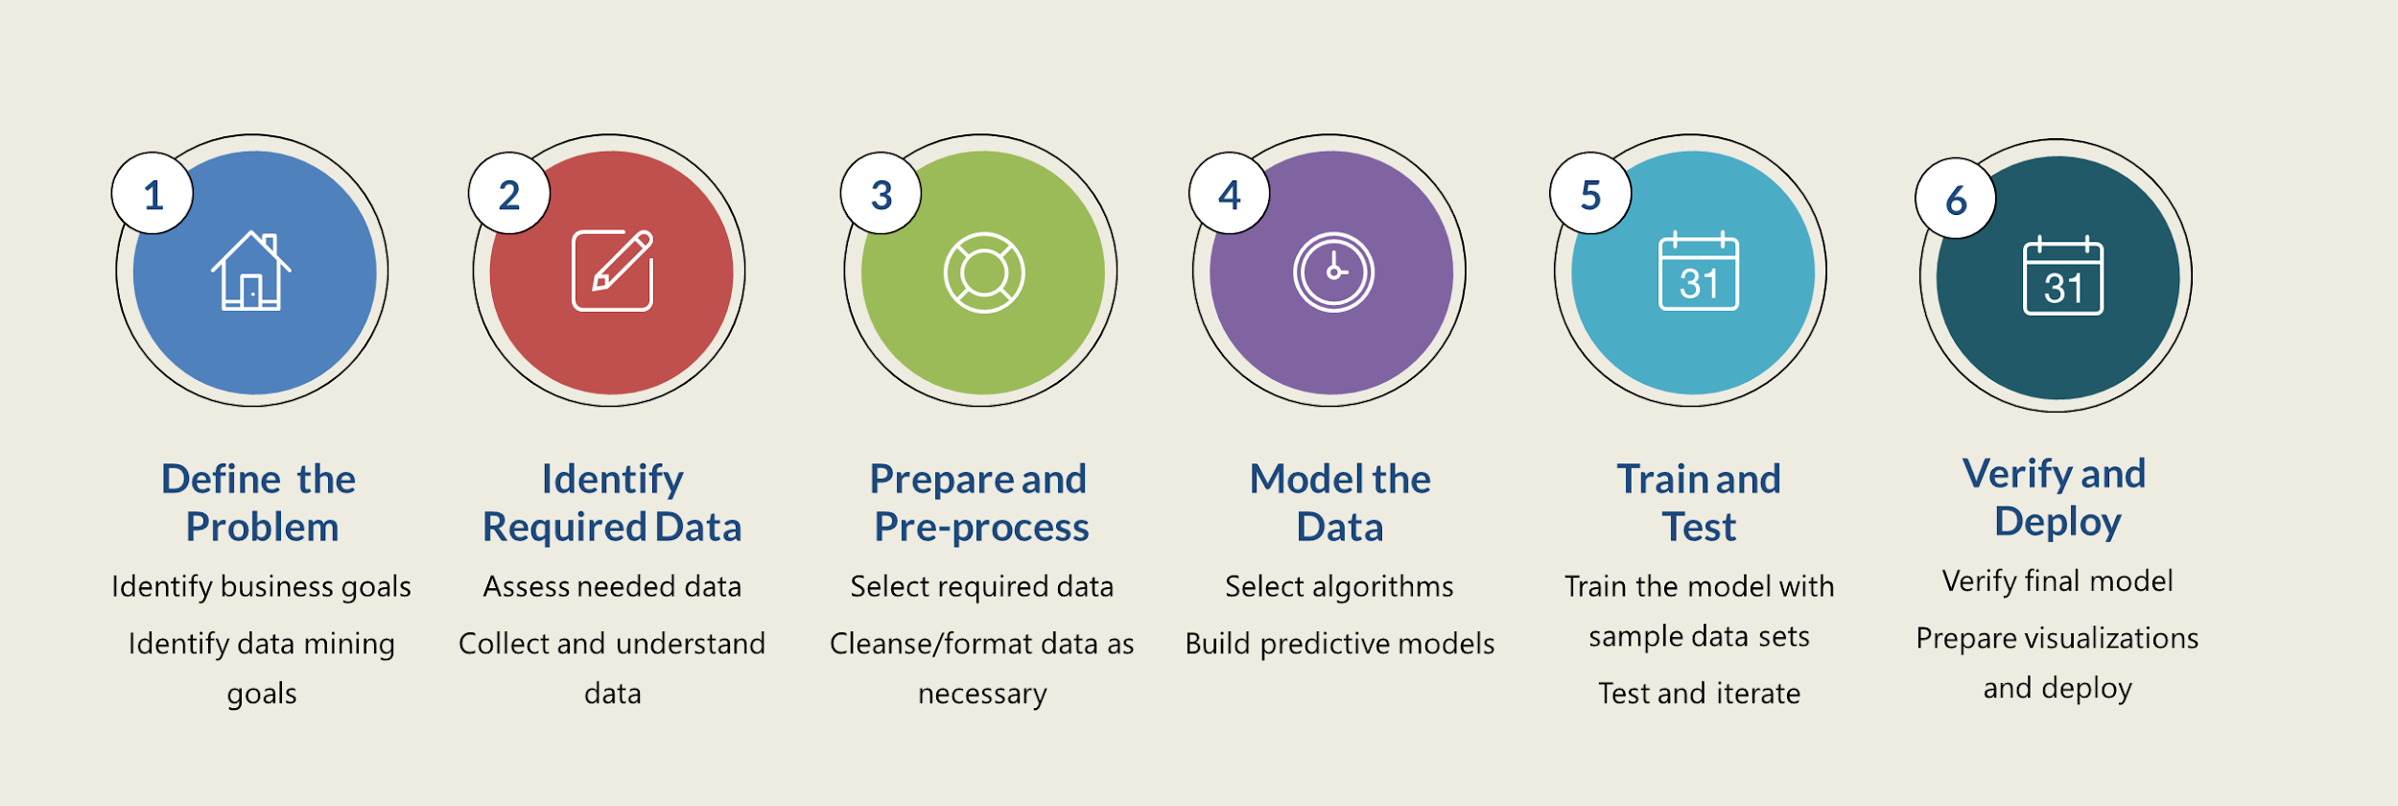
Flow of Presentation

Slide 5

Problem Definition
The problem definition is to generate actionable insights and to identify drivers that improve customer satisfaction.

Slide 6
Data Preprocessing Steps
Our first step in data cleaning was to get rid of white spaces in the cell using trimws() function
We have changed the column names for all the columns
We have removed all the NAs value from the data by replacing it with the mean of the column
We have converted our data to numeric values for analysis

Slide 7
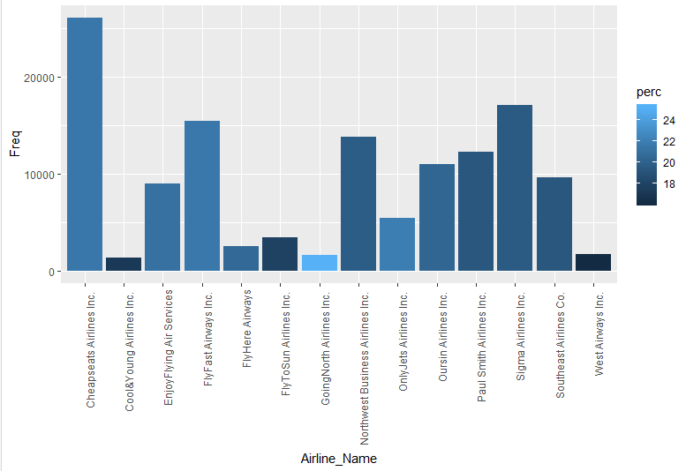
Selecting Data
We chose FlyFast Airlines for two reasons:
We wanted to focus on airline with highest percentage of customer satisfaction value less than 3
We wanted to select an airline with the largest dataset which would be enough to train and test the model.
As we can see from the data below, FlyFast satisfied both the criteria.

Slide 8
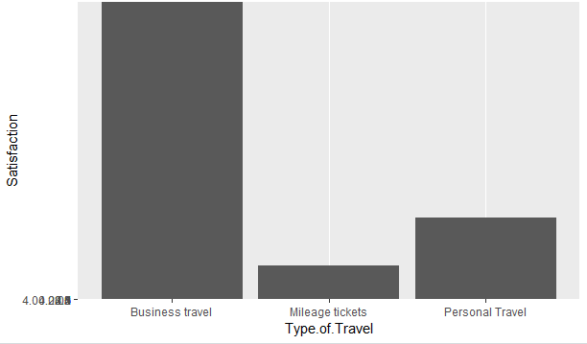
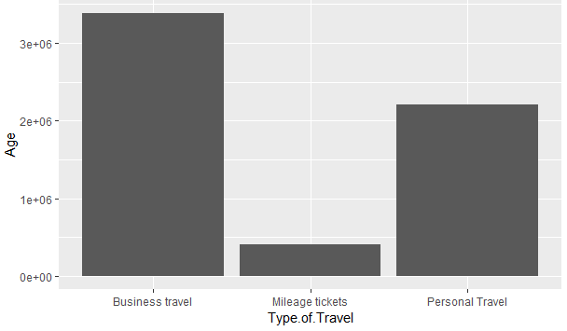
Plots

Slide 9
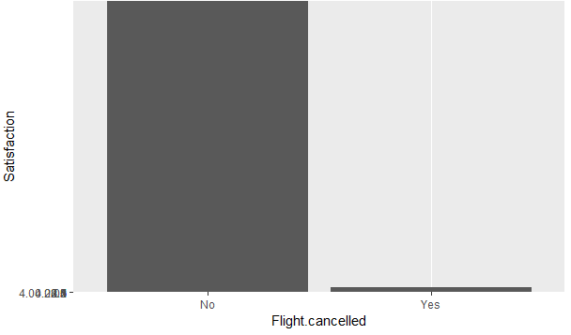
Plots

Slide 10
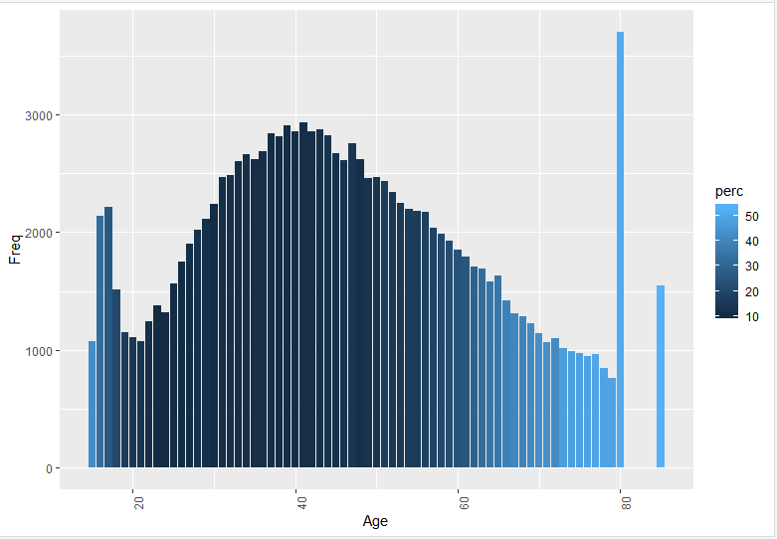
Plots - Dissatisfaction based on Age

Slide 11
Linear Modelling
Statistically significant variables:
-Airline_Status -No_of_Flights_per_annum
-Age -Type_of_Travel
-Gender -Scheduled_Departure_Hour
-Year_of_First_Flight -Flight_cancelled
-Arrival_Delay_greater_5_Mins
We have performed linear modelling on all the variables by removing one variables and checking the fluctuations of R square value.
Significant Variables Multiple R-square Adjusted R-square
Arrival delay greater than 5 mins 0.4052 0.4049
Flight cancelled 0. 4317 0.4314
Schedule dep hour 0.4326 0.4323
Type of travel 0.2289 0.2385
Year of first flight 0.4324 0.4321
Flights per annum 0.4304 0.4301
Gender 0.4286 0.4283
Age 0.4311 0.4308
Airline status 0.3701 0.3707
Final variables from Linear Modelling:
Airline_Status | Gender | No_of_Flights_per_annum | Type_of_Travel | Flight_cancelled | Arrival_Delay_greater_5_Mins | Age

Slide 12
Association Rule Mining
·We started by categorizing the data into buckets.
Created functions for categorizing data into low, average and high.
Data concerning time or duration(Year of first flight, day of month and scheduled departure hour) was made NULL it cannot be categorized.
After applying the function on all variables, they were converted to factors
Algorithm used : Apriori
We considered the following variables with maximum lift.
Airline_Status
Gender
Type of travel
Flight cancelled
lhs rhs support confidence lift count
[41] {Airline_Status=1,
Gender=1,
Type_of_Travel=3,
Airline_Name=4,
Flight_cancelled=1} => {Satisfaction=Low} 0.1015772 0.6597808 3.048049 1565
Association Rule : Support = 0.1, Confidence = 0.5

Slide 13
Support Vector Machines (SVM)
We used the variables which were most significant from the linear modeling and the association rule mining. Below variables were used:
Airline Status
Gender
Type of Travel
Flight Cancelled
Output:
Support Vector Machine object of class "ksvm"
Objective Function Value : -129825.9
Training error : 0.149913
Cross validation error : 0.150029
Probability model included.
Error percentage - 14%
Which is a very good error rate.

Slide 14
Thank you.

